Slide 1




Accounting for variation in detection probability when inferring eradication
Masters of Philosophy (Applied Statistics) | School of Mathematics
Queensland University of Technology
Sean Martin, Zachary Carter, Leah South, Michael Bode
Notes:
Privilege to have you as an audience

Slide 2
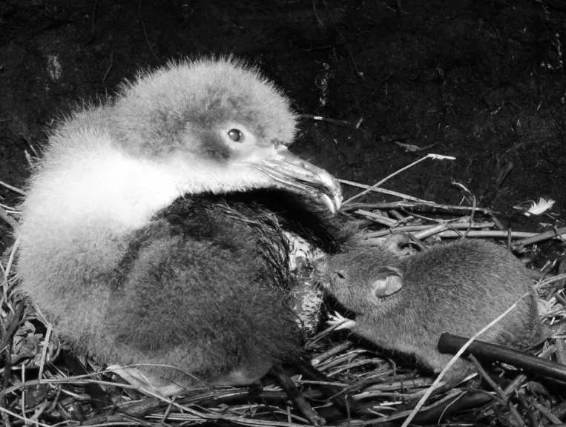
Motivation
Invasive species are driving island biodiversity towards extinction.
Island species have not evolved defences against invasive species.
Eradication of invasive species is cost-effective and provides best conservation outcomes.
Instrumental in the recovery of numerous threatened island species.
Doherty et al., 2015
Veitch et al., 2019
Spatz et al., 2022
(Dilley, 2014)
Sean Martin | Queensland University of Technology
Notes:
Invasive species driving naïve island biodiversity towards extinction
because island species evolved without pressure from invasives, many are yet to evolved defensive behaviours towards invasive species, leaving them incredibly vulnerable.
To preserve threatened island species, it’s necessary to remove the pressure invasive species place on them
The most cost-effective method is eradication of invasive species from the island of interest.
Eradications of invasive species have been instrumental in brining numerous island endemic species back from the brink of extinction.

Slide 3

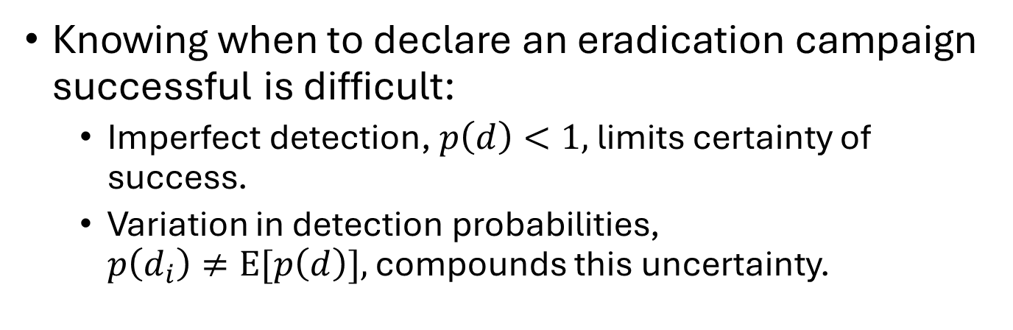
The challenge
Knowing when to declare an eradication campaign successful is difficult:
Imperfect detection, $p\left(d\right)<1,$ limits certainty of success.
Variation in detection probabilities, $p\left(d_{i}\right)≠E[p\left(d\right)],$ compounds this uncertainty.
Morrison et al., 2007
Christy et al., 2010
Guillera-Arroita, 2017
Johnstone, McArthur, & Banks, 2021
Sean Martin | Queensland University of Technology
Notes:
Each campaign is a unique and complex activity, but they will all face one key challenge; when to declare eradication and end the campaign
Knowing when to declare eradication is difficult for many reasons

Slide 4

The challenge
Knowing when to declare an eradication campaign successful is difficult:
Imperfect detection, $p\left(d\right)<1,$ limits certainty of success.
Variation in detection probabilities, $p\left(d_{i}\right)≠E[p\left(d\right)],$ compounds this uncertainty.
Eradication inference models account for imperfect detection, but not variation detection probabilities.
Rout, 2017
Morrison et al., 2007
Sean Martin | Queensland University of Technology

Slide 5
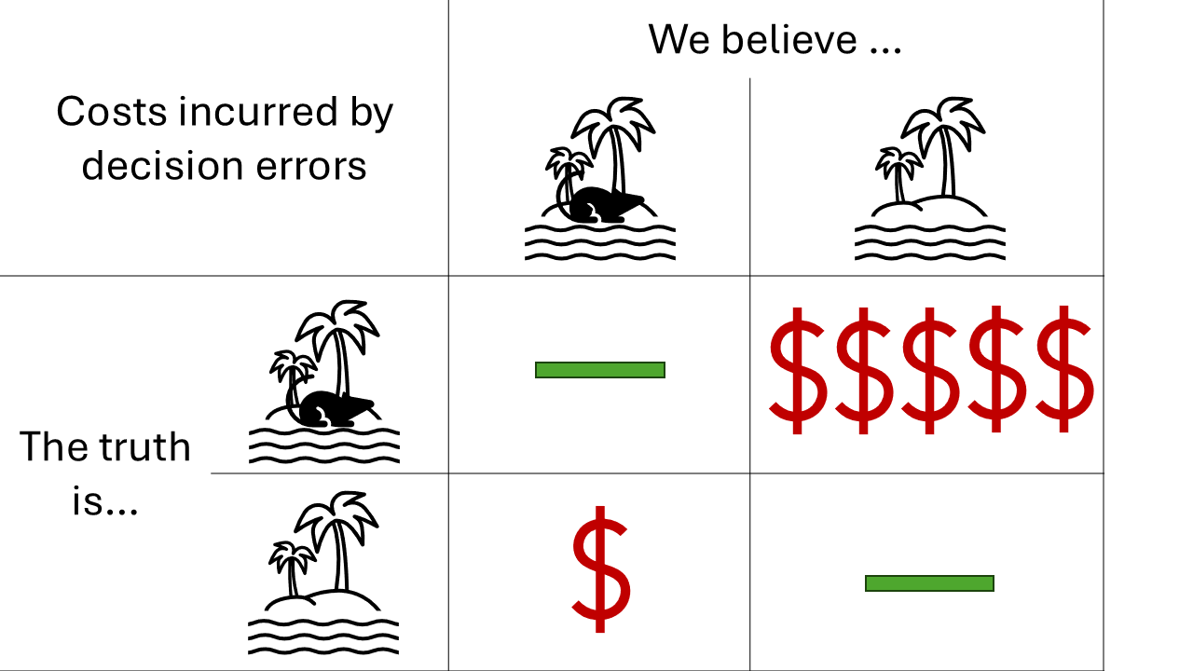
Is variation in detection probabilities really a problem?
Small errors can lead to large consequences when informing management decisions
i.e. when to end the campaign
End campaign prematurely = $$$$$$$
Continue search unnecessarily = $ + $ + $ + …
Money is limited
Bennett et al., 2024
Regan et al., 2006
Sean Martin | Queensland University of Technology
Notes:
Small biases could lead to large consequences
example, should a statistical model be overly confident in an underestimate of 0 for the remaining population size, when in fact 1 or more individuals remain, this information lead a manager to make the wrong decision and end the campaign early, committing a false-positive error.
This error incurs the tangible costs of …, as well as the massive but intangible costs of …
In contrast, should the manager decide to continue searching for a population after the last individual has been removed, this commits a false-negative error. The cost incurred by this error is relatively small in comparison, …. However, these costs incurred by false-negative errors are cumulative, and can rival the tangible costs incurred by false-positive errors should the campaign continue for too long.

Slide 6
Aims
Assess whether ignoring variation in detection probabilities lead to overestimates of successful eradication when individual detection probabilities vary.
Develop a statistical model that allowed for variation in individual detection probabilities.
Sean Martin | Queensland University of Technology
Notes:
So, given the risk that heterogeneous detection may present in an eradication context, this project aimed to … in particular, how heterogeneity influences the rate of false positive errors and volume of false-negative errors
Should the influence be substantial, our secondary aim was to produce a novel statistical model that accounts for some form of heterogeneity in detection.

Slide 7
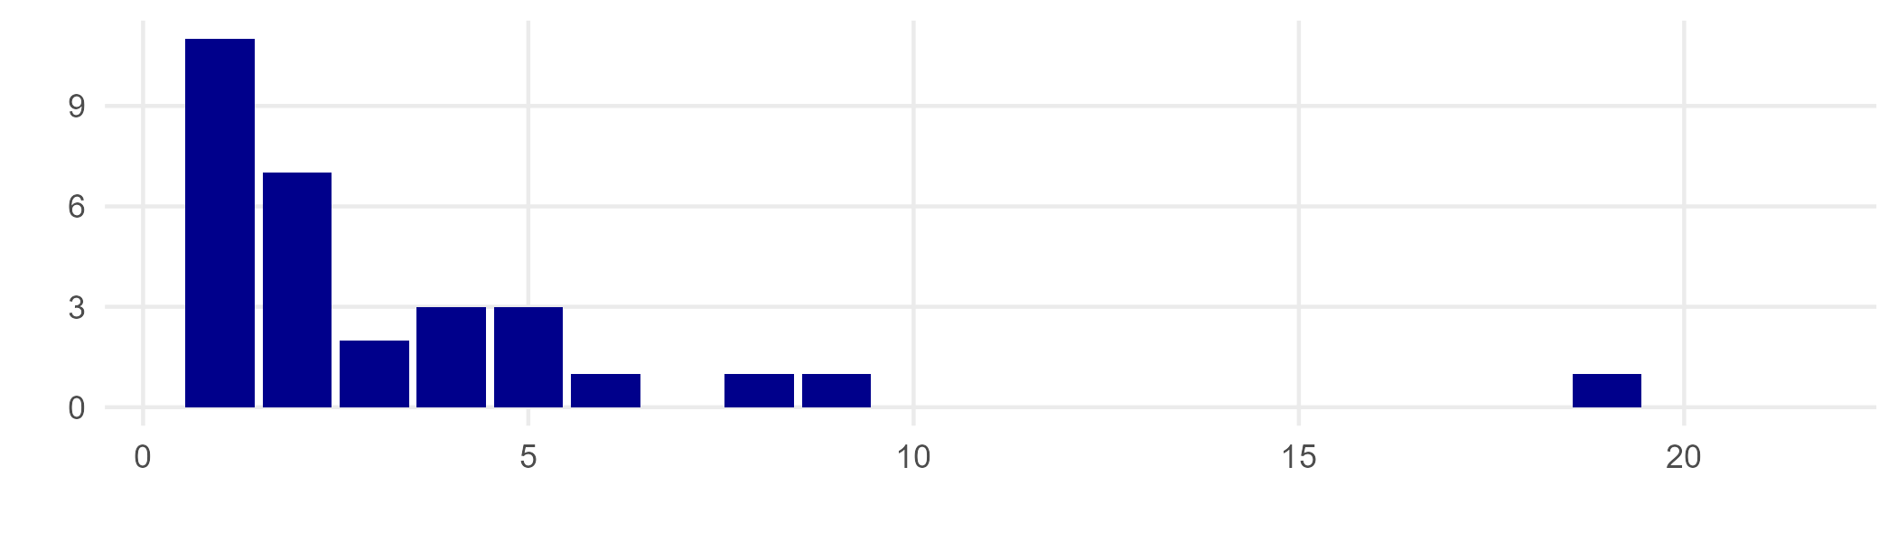

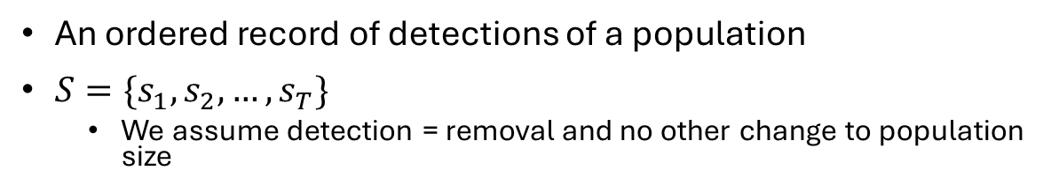



Sighting records
Slide variables:
$S:$ The sighting record
$S_{Σ}$: The sum of individuals detected in the sighting record
$s_{t}:$ Number removed during sampling period $t$
$T:$ The final sampling period of the sighting record
An ordered record of detections of a population
$S=\{s_{1}, s_{2},…,s_{T}\}$
We assume detection = removal and no other change to population size
$$S_{Σ}$$
Number of detections
$$s_{t}$$
Sampling period $(t)$
Sean Martin | Queensland University of Technology
Notes:
First we need to talk about the data we’re working with. The progress of an eradication campaign is measured through the sighting record it produces. For simplicity, we assume that each detection equals a removal. We define the total number of individuals detected in the sighting record as S_\Sigma, and the number of individuals detected within a sampling period as s_t.

Slide 8
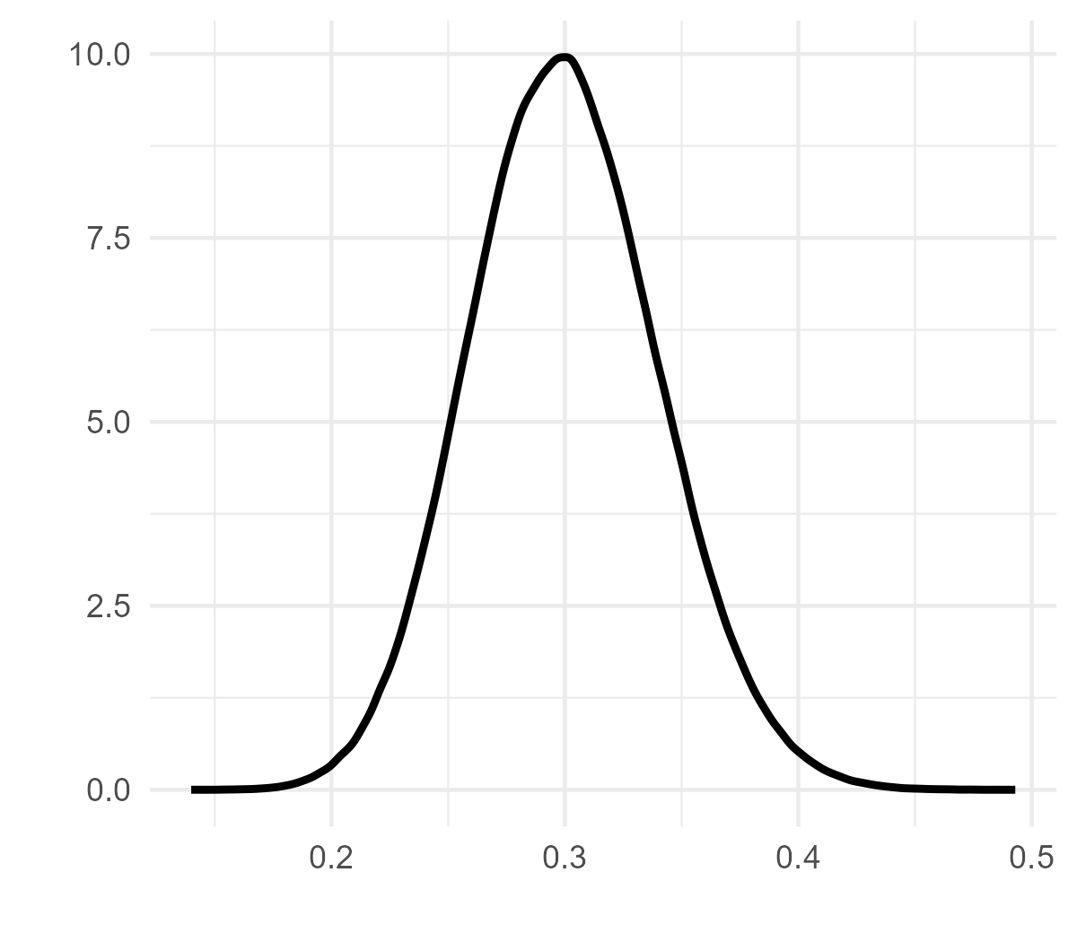
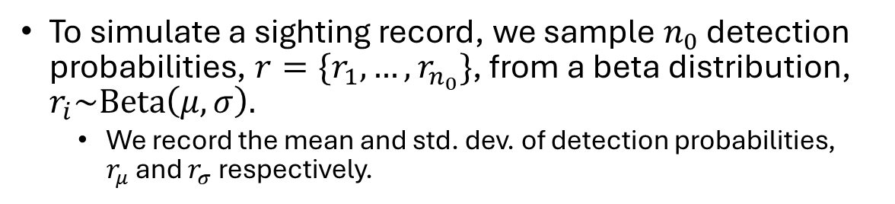


Data generation
Slide variables:
$n_{0}:$ Initial population size
$r_{i}:$ Individual probability of detection
$μ:$ Mean of detection probability sampling distribution
$σ:$ Std. dev. of detection probability sampling distribution
$r_{μ}:$ Mean of detection probabilities
$r_{σ}:$ Std. dev. of detection probabilities
To simulate a sighting record, we sample $n_{0}$ detection probabilities, $r=\{r_{1},…,r_{n_{0}}\}$, from a beta distribution, $r_{i}\sim Beta\left(μ, σ\right).$
We record the mean and std. dev. of detection probabilities, $r_{μ}$and $r_{σ}$ respectively.
Density
$$p(r)$$
Sean Martin | Queensland University of Technology
Notes:
As a campaign progresses and more time passes since the last detection, one must ask whether the las individual detected was indeed the last extant individual of the target population. That is, does S_\Sigma = n_0, where n_0 is the size of the initial population.

Slide 9
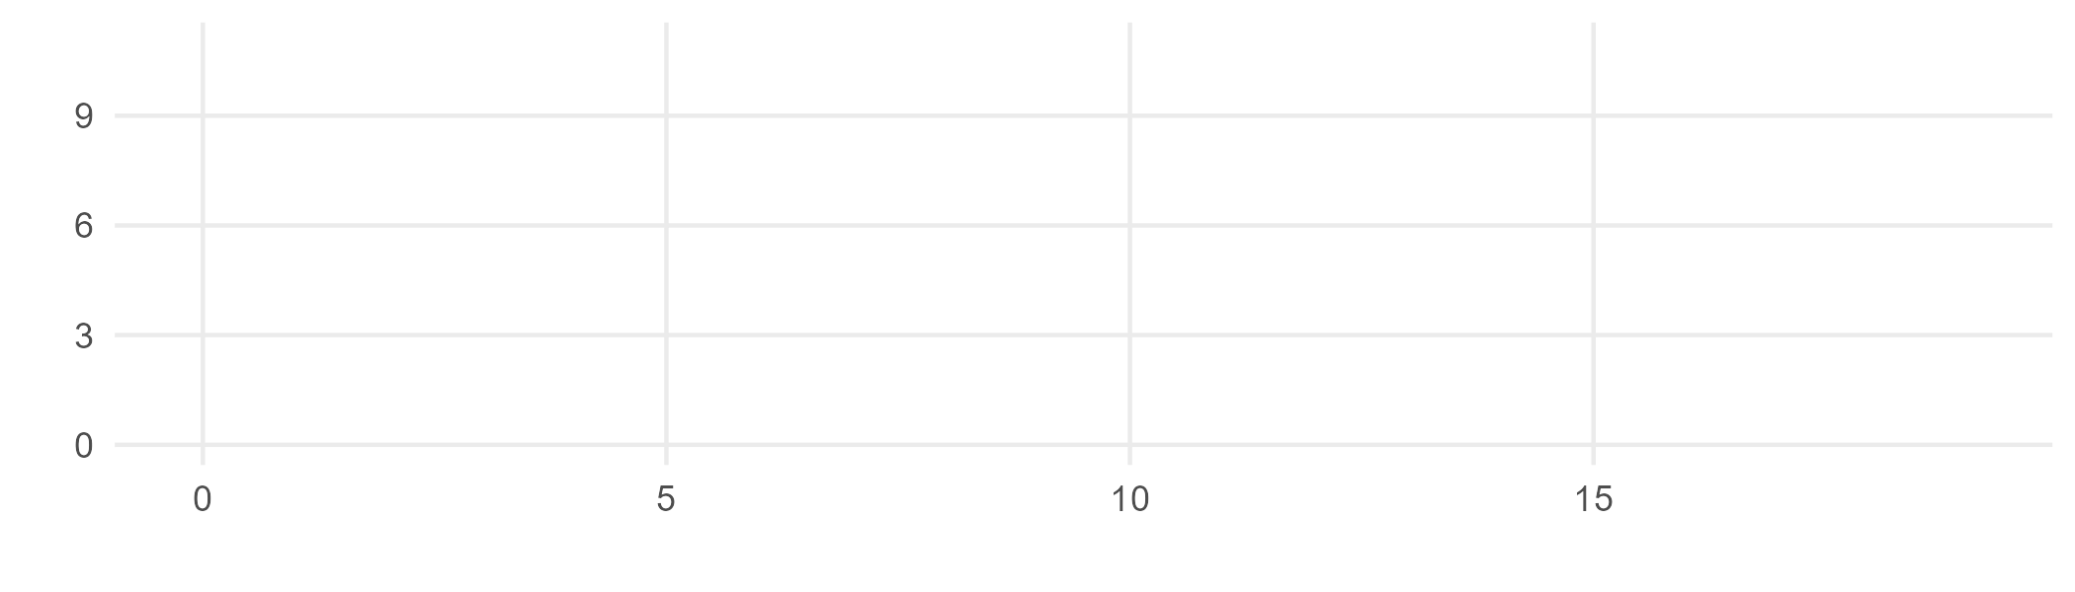
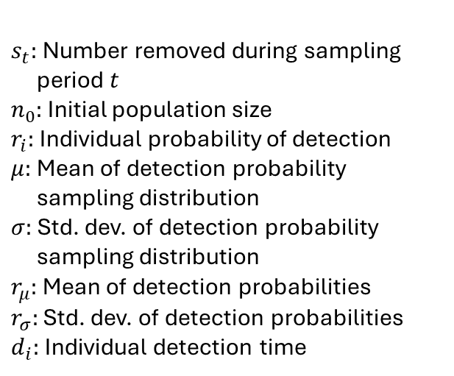

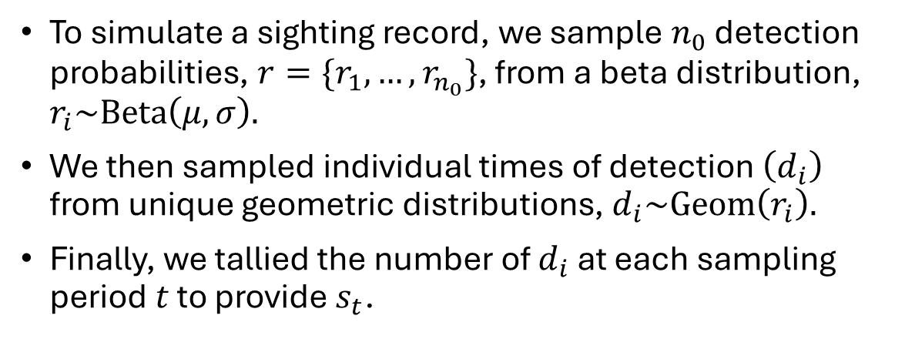
Data generation
Slide variables:
$s_{t}:$ Number removed during sampling period $t$
$n_{0}:$ Initial population size
$r_{i}:$ Individual probability of detection
$μ:$ Mean of detection probability sampling distribution
$σ:$ Std. dev. of detection probability sampling distribution
$r_{μ}:$ Mean of detection probabilities
$r_{σ}:$ Std. dev. of detection probabilities
$d_{i}:$ Individual detection time
To simulate a sighting record, we sample $n_{0}$ detection probabilities, $r=\{r_{1},…,r_{n_{0}}\}$, from a beta distribution, $r_{i}\sim Beta\left(μ, σ\right).$
We then sampled individual times of detection $\left(d_{i}\right)$ from unique geometric distributions, $d_{i}\sim Geom\left(r_{i}\right).$
Finally, we tallied the number of $d_{i}$ at each sampling period $t$ to provide $s_{t}$.
Number of detections
Sampling period $(t)$
Sean Martin | Queensland University of Technology
Notes:
As a campaign progresses and more time passes since the last detection, one must ask whether the las individual detected was indeed the last extant individual of the target population. That is, does S_\Sigma = n_0, where n_0 is the size of the initial population.

Slide 10


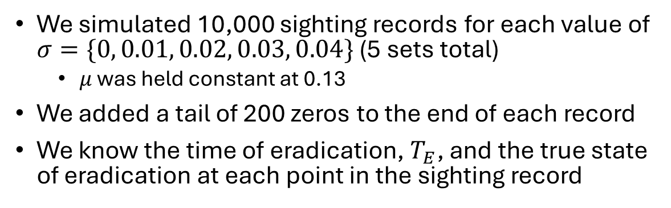
Data generation
Slide variables:
$s_{t}:$ Number removed during sampling period $t$
$μ:$ Mean of detection probability sampling distribution
$σ:$ Std. dev. of detection probability sampling distribution
$T_{E}:$ Time of eradication (last detection)
We simulated 10,000 sighting records for each value of $σ=\{0, 0.01, 0.02, 0.03, 0.04\}$ (5 sets total)
$μ$ was held constant at 0.13
We added a tail of 200 zeros to the end of each record
We know the time of eradication, $T_{E}$, and the true state of eradication at each point in the sighting record
$$T_{E}$$
Number of detections
Sampling period $(t)$
Sean Martin | Queensland University of Technology
Notes:
As a campaign progresses and more time passes since the last detection, one must ask whether the las individual detected was indeed the last extant individual of the target population. That is, does S_\Sigma = n_0, where n_0 is the size of the initial population.

Slide 11
Deriving eradication inference model
We derived a binomial Bayesian eradication inference model similar to one presented by Ramsey, Parkes, & Morrison (2009).
The model assumes homogeneous detection.
The model is numerically tractable due to simplifying assumptions.
Sean Martin | Queensland University of Technology

Slide 12


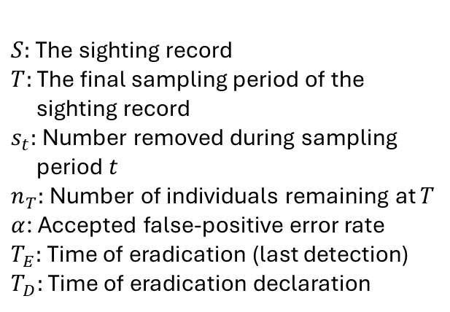






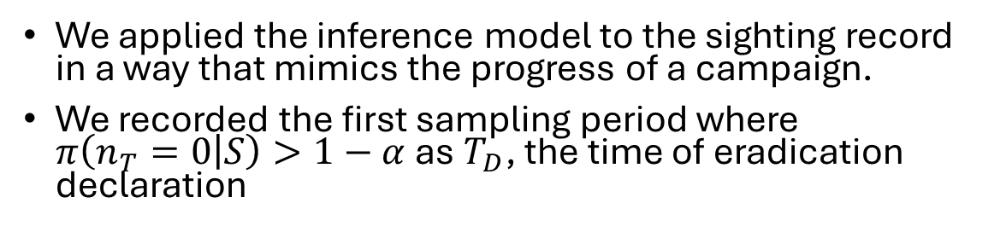


Applying the eradication inference model
Slide variables:
$S:$ The sighting record
$T:$ The final sampling period of the sighting record
$s_{t}:$ Number removed during sampling period $t$
$n_{T}:$ Number of individuals remaining at $T$
$α$: Accepted false-positive error rate
$T_{E}:$ Time of eradication (last detection)
$T_{D}:$ Time of eradication declaration
We applied the inference model to the sighting record in a way that mimics the progress of a campaign.
We recorded the first sampling period where $π\left(n_{T}=0 | S\right)>1−α$ as $T_{D}$, the time of eradication declaration
$$T_{1}$$
$$T_{2}$$
$$T_{3}$$
$$T_{4}$$
$$T_{5}$$
$$T_{6}$$
$$T_{7}$$
$$T_{D}$$
$$T_{9}$$
$$T_{10}$$
$$T_{E}$$
Number of detections
Sampling period $(t)$
Sean Martin | Queensland University of Technology
Notes:
As a campaign progresses and more time passes since the last detection, one must ask whether the las individual detected was indeed the last extant individual of the target population. That is, does S_\Sigma = n_0, where n_0 is the size of the initial population.

Slide 13
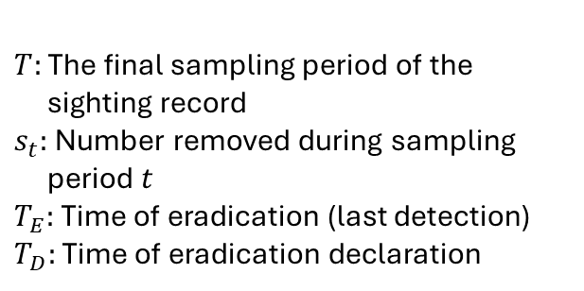
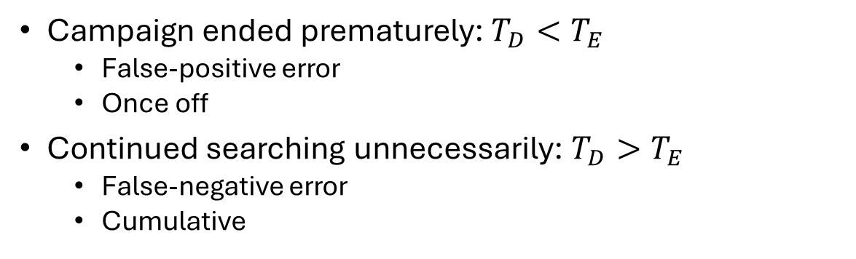
Testing the influence of detection heterogeneity on error rates
Slide variables:
$T:$ The final sampling period of the sighting record
$s_{t}:$ Number removed during sampling period $t$
$T_{E}:$ Time of eradication (last detection)
$T_{D}:$ Time of eradication declaration
Campaign ended prematurely: $T_{D}<T_{E}$
False-positive error
Once off
Continued searching unnecessarily: $T_{D}>T_{E}$
False-negative error
Cumulative
$$T_{1}$$
$$T_{2}$$
$$T_{3}$$
$$T_{4}$$
$$T_{5}$$
$$T_{6}$$
$$T_{7}$$
$$T_{D}$$
$$T_{9}$$
$$T_{10}$$
$$T_{E}$$
Number of detections
Sampling period $(t)$
Sean Martin | Queensland University of Technology
Notes:
As a campaign progresses and more time passes since the last detection, one must ask whether the las individual detected was indeed the last extant individual of the target population. That is, does S_\Sigma = n_0, where n_0 is the size of the initial population.

Slide 14
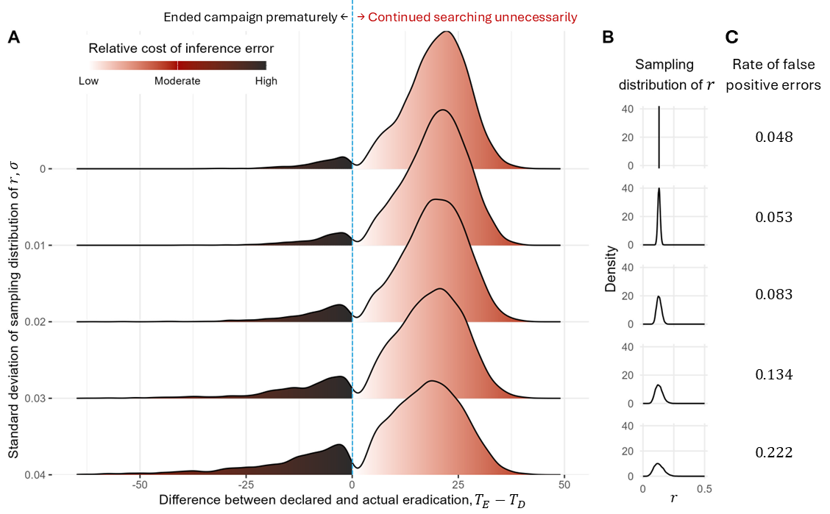
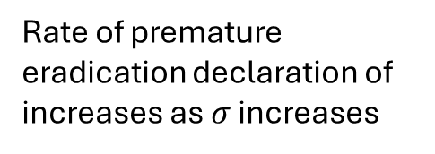
Testing the influence of variation in detection on error rates
Rate of premature eradication declaration of increases as $σ$ increases
Sean Martin | Queensland University of Technology
Notes:
As a campaign progresses and more time passes since the last detection, one must ask whether the las individual detected was indeed the last extant individual of the target population. That is, does S_\Sigma = n_0, where n_0 is the size of the initial population.

Slide 15
What have we learned so far?
Ignoring variation in individual detection probabilities → increased rates of premature declarations of eradication.
Variation in individual detectability can not be considered as ignorable noise.
Sean Martin | Queensland University of Technology
Notes:
As a campaign progresses and more time passes since the last detection, one must ask whether the las individual detected was indeed the last extant individual of the target population. That is, does S_\Sigma = n_0, where n_0 is the size of the initial population.

Slide 16
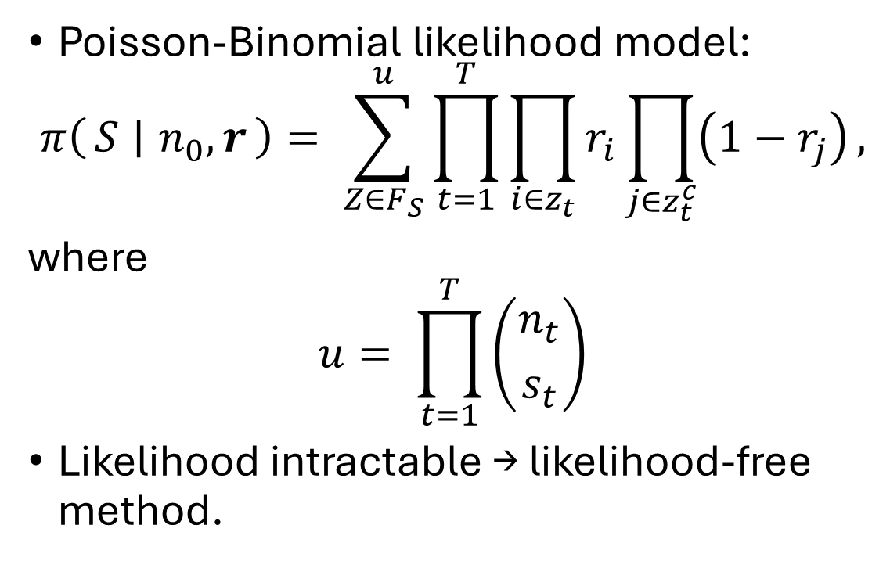
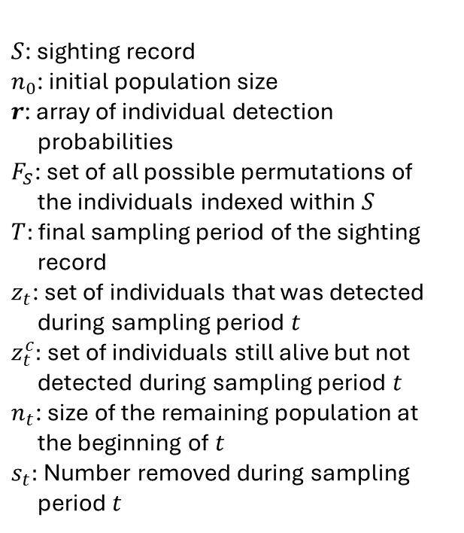
Can we allow for variation in detection probabilities in an eradication inference model?
Slide variables:
Poisson-Binomial likelihood model:
$$π\left(S ∣ n_{0},r\right)= \sum_{Z∈F_{S}}^{u}{\prod_{t=1}^{T}{\prod_{i∈z_{t}}{r_{i}\prod_{j∈z_{t}^{c}}{\left(1−r_{j}\right)}}}},$$
where
$$u= \prod_{t=1}^{T}{\left({n_{t} \atop s_{t}}\right)}$$
Likelihood intractable → likelihood-free method.
$S$: sighting record
$n_{0}$: initial population size
$r$: array of individual detection probabilities
$F_{S}$: set of all possible permutations of the individuals indexed within $S$
$T:$ final sampling period of the sighting record
$z_{t}$: set of individuals that was detected during sampling period $t$
$z_{t}^{c}$: set of individuals still alive but not detected during sampling period $t$
$n_{t}$: size of the remaining population at the beginning of $t$
$s_{t}:$ Number removed during sampling period $t$
Sean Martin | Queensland University of Technology
Notes:
Practice this one!]

Slide 17

Can we allow for variation in detection probabilities in an eradication inference model?
We developed an ABC-SMC model to estimate ${θ=\{n}_{T}, μ, σ\}$.
ABC-SMC because it is:
Efficient
Robust to multi-modal posteriors
Easily parallelisable
(Sisson et al., 2018)
Sean Martin | Queensland University of Technology
Notes:
Practice this one!]

Slide 18
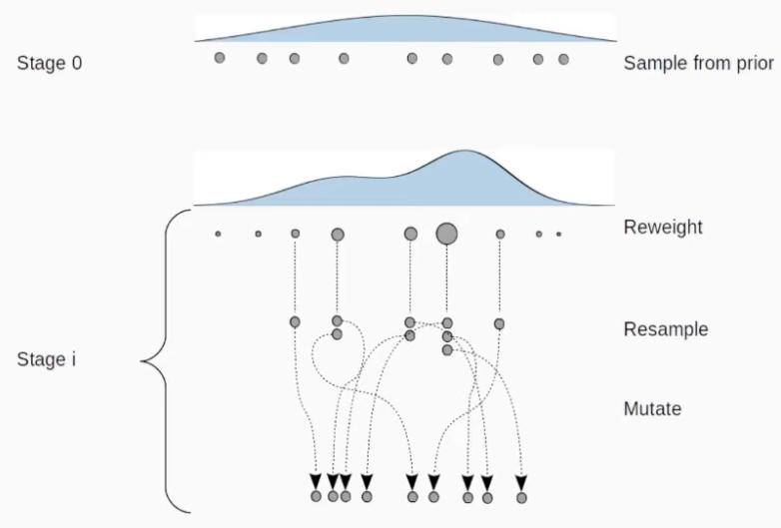
ABC-SMC description
Martin & German-Ramirez, 2020
Sean Martin | Queensland University of Technology

Slide 19
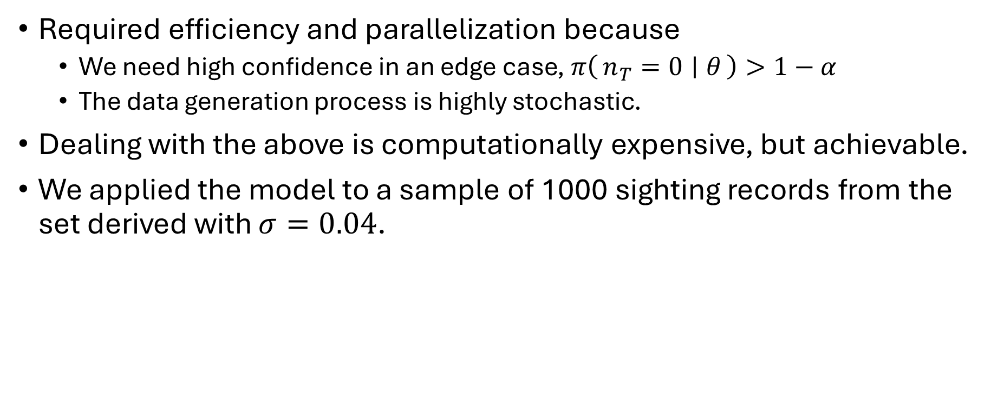
Can we allow for variation in detection probabilities in an eradication inference model?
Required efficiency and parallelization because
We need high confidence in an edge case, $π\left(n_{T}=0 ∣ θ\right)>1−α$
The data generation process is highly stochastic.
Dealing with the above is computationally expensive, but achievable.
We applied the model to a sample of 1000 sighting records from the set derived with $σ=0.04$.
Sean Martin | Queensland University of Technology
Notes:
Practice this one!]

Slide 20
The outcome
Still fine tuning the model!
Preliminary results show:
false-positive error rate
expected number of cumulative false-negative errors
Model requires more evidence to reach the same level of certainty of eradication success
Sean Martin | Queensland University of Technology

Slide 21
Limitations
Stochasticity inherent in ABC analyses
Is a proof of concept - cannot be applied to case studies yet
Need to include catch effort at a minimum
Only examines fixed individual differences in detection probabilities
Other forms of variation (e.g. cyclical or stochastic temporal) exist
Sean Martin | Queensland University of Technology

Slide 22
Conclusions
Individual variation in detection probabilities cannot be considered as ignorable noise.
What other forms of variation cannot be considered as ignorable noise?
It is now feasible to evaluate eradication inference models that allow for some variation in detection probabilities with readily accessible computational resources.
Sean Martin | Queensland University of Technology

Slide 23
Acknowledgements and thanks
You! & Biometrics organising committee
All my supervisors and Dr David Warne
Sean Martin | Queensland University of Technology

Slide 24
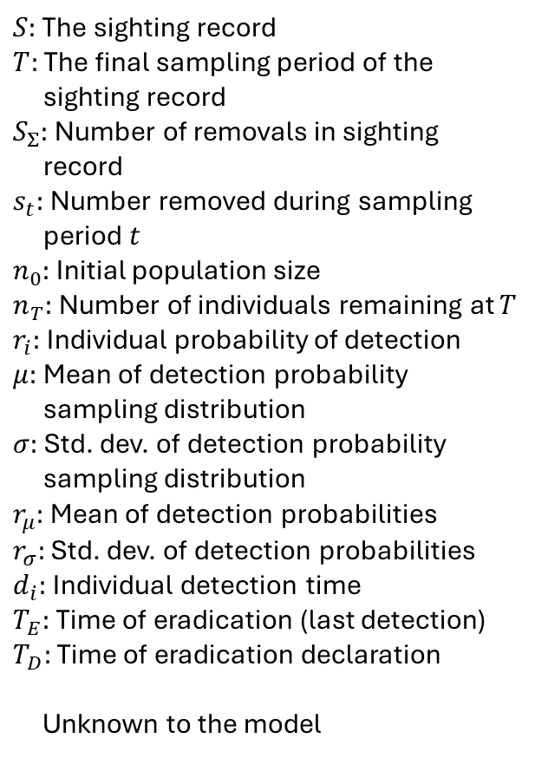
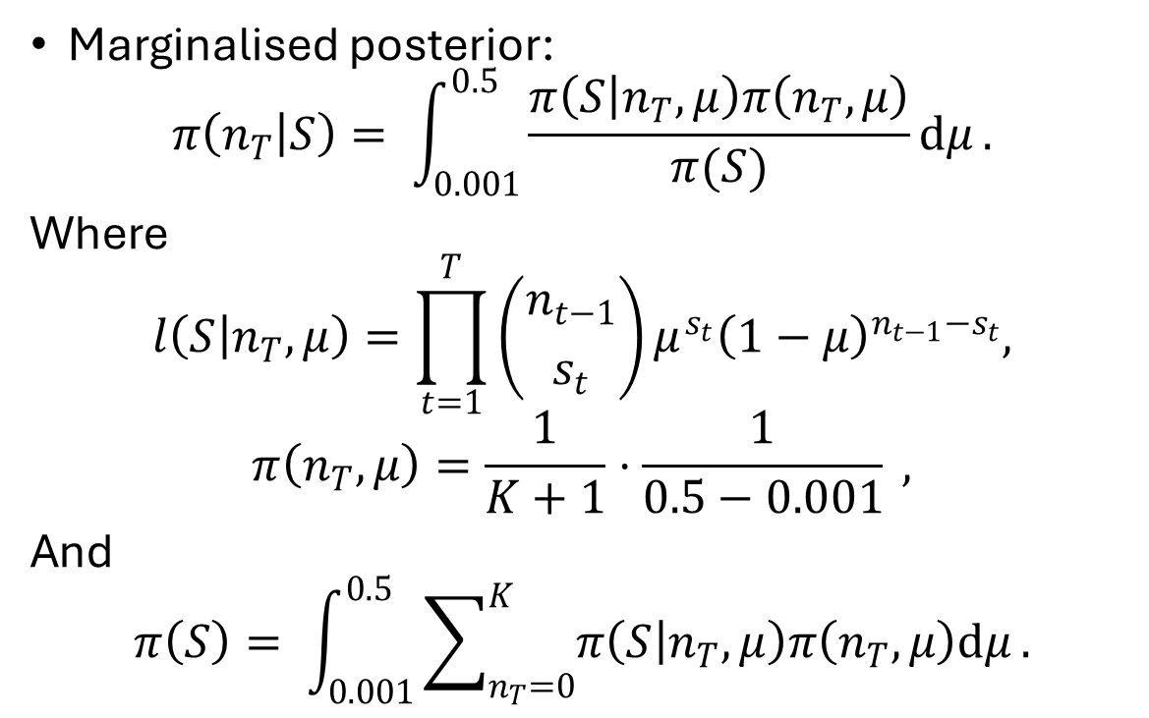
Bayesian model
$S:$ The sighting record
$T:$ The final sampling period of the sighting record
$S_{Σ}:$ Number of removals in sighting record
$s_{t}:$ Number removed during sampling period $t$
$n_{0}:$ Initial population size
$n_{T}:$ Number of individuals remaining at $T$
$r_{i}:$ Individual probability of detection
$μ:$ Mean of detection probability sampling distribution
$σ:$ Std. dev. of detection probability sampling distribution
$r_{μ}:$ Mean of detection probabilities
$r_{σ}:$ Std. dev. of detection probabilities
$d_{i}:$ Individual detection time
$T_{E}:$ Time of eradication (last detection)
$T_{D}:$ Time of eradication declaration
Unknown to the model
Marginalised posterior:
$$π\left(n_{T} | S\right)= \int_{0.001}^{0.5}{\frac{π\left(S | n_{T}, μ\right)π\left(n_{T}, μ\right)}{π(S)}dμ}.$$
Where
$$l\left(S | n_{T}, μ\right)=\prod_{t=1}^{T}{\left({n_{t−1} \atop s_{t}}\right)}μ^{s_{t}}{\left(1−μ\right)}^{n_{t−1}−s_{t}},$$
$$π\left(n_{T}, μ\right)=\frac{1}{K+1}⋅\frac{1}{0.5−0.001} ,$$
And
$$π\left(S\right)= \int_{0.001}^{0.5}{\sum_{n_{T}=0}^{K}{π\left(S | n_{T}, μ\right)π\left(n_{T},μ\right)dμ}}.$$
Sean Martin | Queensland University of Technology

Slide 25
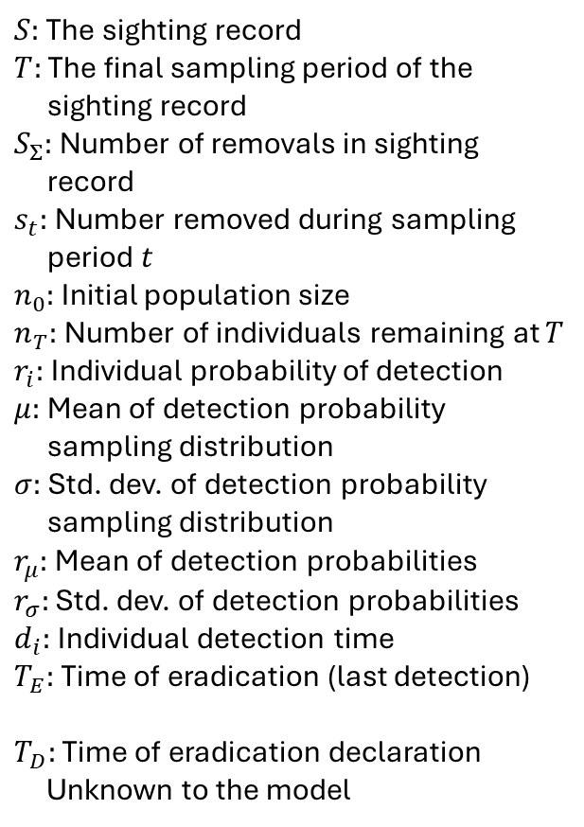
Data generation
$S:$ The sighting record
$T:$ The final sampling period of the sighting record
$S_{Σ}:$ Number of removals in sighting record
$s_{t}:$ Number removed during sampling period $t$
$n_{0}:$ Initial population size
$n_{T}:$ Number of individuals remaining at $T$
$r_{i}:$ Individual probability of detection
$μ:$ Mean of detection probability sampling distribution
$σ:$ Std. dev. of detection probability sampling distribution
$r_{μ}:$ Mean of detection probabilities
$r_{σ}:$ Std. dev. of detection probabilities
$d_{i}:$ Individual detection time
$T_{E}:$ Time of eradication (last detection)
$T_{D}:$ Time of eradication declaration
Unknown to the model
Assumptions:
Detection probabilities are constant through time and independent
Detection = immediate removal
Detections per sampling period not capped
Number of detections
Sampling period $(t)$
Sean Martin | Queensland University of Technology

Slide 26
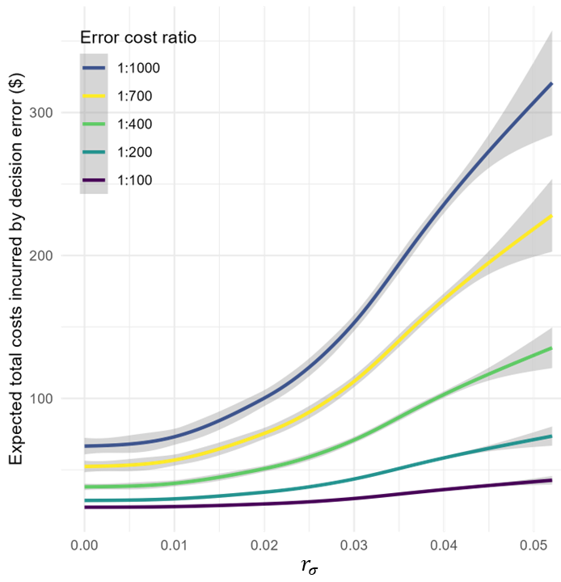
The influence of heterogeneity on expected cost incurred by errors
Costs incurred by false-positive errors dominate expected costs incurred by decision errors
Increases in detection heterogeneity drive expected costs higher
Sean Martin | Queensland University of Technology
Notes:
As a campaign progresses and more time passes since the last detection, one must ask whether the las individual detected was indeed the last extant individual of the target population. That is, does S_\Sigma = n_0, where n_0 is the size of the initial population.

Slide 27
Methods
Simulation study
Simulated data with variation in individual detection probabilities from known parameters
Derived Bayesian inference model that ignores variation in individual detection probabilities
Applied inference model to simulated data
Novel eradication inference model
Developed an ABC-SMC model that allows variable detection
Tested on previously simulated data
Sean Martin | Queensland University of Technology
Notes:
To achieve these aims, we conducted an initial simulation study; we …
This may put the cart before the horse, but we also…

Slide 28
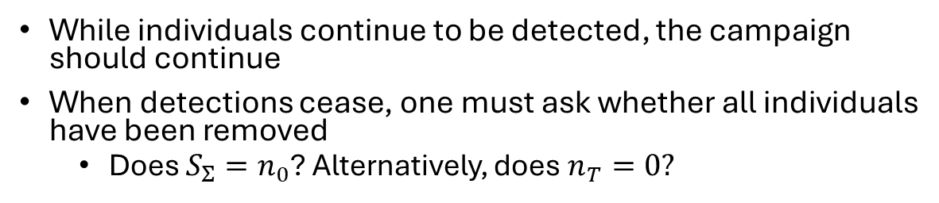


Sighting records
$S:$ The sighting record
$T:$ The final sampling period of the sighting record
$S_{Σ}:$ Number of removals in sighting record
$s_{t}:$ Number removed during sampling period $t$
$n_{0}:$ Initial population size
$n_{T}:$ Number of individuals remaining at $T$
$r_{i}:$ Individual probability of detection
$μ:$ Mean of detection probability sampling distribution
$σ:$ Std. dev. of detection probability sampling distribution
$r_{μ}:$ Mean of detection probabilities
$r_{σ}:$ Std. dev. of detection probabilities
$d_{i}:$ Individual detection time
$T_{E}:$ Time of eradication (last detection)
$T_{D}:$ Time of eradication declaration
Unknown to the model
While individuals continue to be detected, the campaign should continue
When detections cease, one must ask whether all individuals have been removed
Does $S_{Σ}=n_{0}$? Alternatively, does $n_{T}=0?$
$$S_{Σ}$$
Number of detections
$$s_{t}$$
Sampling period $(t)$
Sean Martin | Queensland University of Technology
Notes:
As a campaign progresses and more time passes since the last detection, one must ask whether the las individual detected was indeed the last extant individual of the target population. That is, does S_\Sigma = n_0, where n_0 is the size of the initial population.

Slide 29
Is variation in detection probabilities really a problem?
Ignoring variation in detection probabilities:
Underestimates population parameters
Overestimates confidence in parameter estimates
But:
Biases are small
Has yet to be shown for eradication (removal) models
Gimenez, Cam, & Gaillard, 2018
Sean Martin | Queensland University of Technology
Notes:
Capture-mark-recapture studies on populations of conservation interest have shown that ignoring heterogeneous detection..
Population parameters such as population size
However, biases in parameter estimates are small
Eradication models are a different statistical problem

